Slide 1
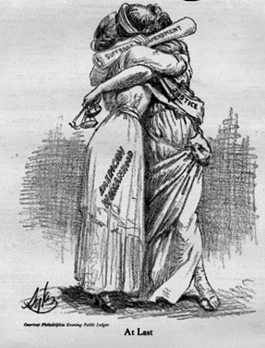
AT LAST!
Notes:
Nellie the Suffragist Presentation.
At Last! Today, August 27, 1920 will go down in history as the day that changed America. Today Secretary of State Colby signed the proclamation affirming the Woman Suffrage Amendment. The 19th Amendment . We now have the vote. But the drama of the last ten days!
…that began when Tennessee narrowly became the last state needed for ratification. But the drama really started before that when NC had the chance to be that state. But it was defeated. Not only was it defeated, but 68 NC legislators, all men, signed a telegram and sent it to Tennessee telling them not to ratify. Well after Tennessee ratified, what happened?
The anti-suffragists took it to court, claiming legislators were bribed for their votes. The other side accused the anti-suffragists of being bribed. There were petitions to the courts all over the place in some states…asking that their ratifications be overturned.
Well…it all settled down and it was passed. How did it happen? Women had no power in the marble halls of government…not at the local, state or federal level. So they turned to POLITICAL THEATER. This new-fangled machine is better than the NICKELODEON down by the emporium.

Slide 2
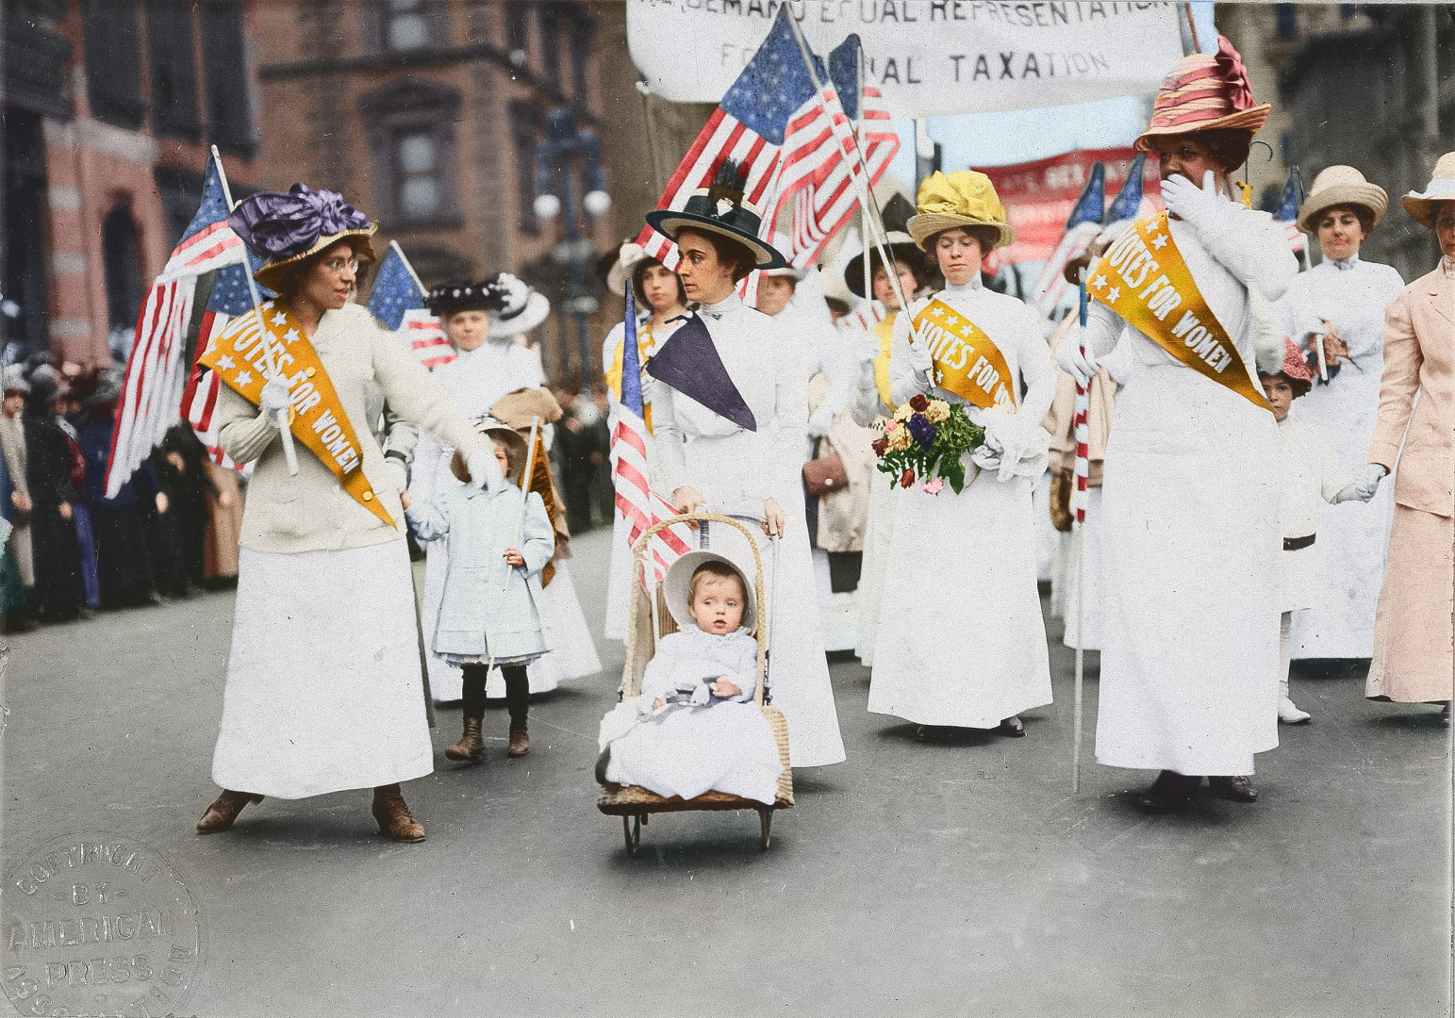
the suffragists
Masters of Political Theater
Notes:
They used parades, symbols, dance, song, theater, silent film, literature….and public, political theater that got attention in the newspapers. You see those stories in the Wilmington Morning Star every day! Parades, often called processions, were all over the place. But let’s take a look back at the beginning.

Slide 3
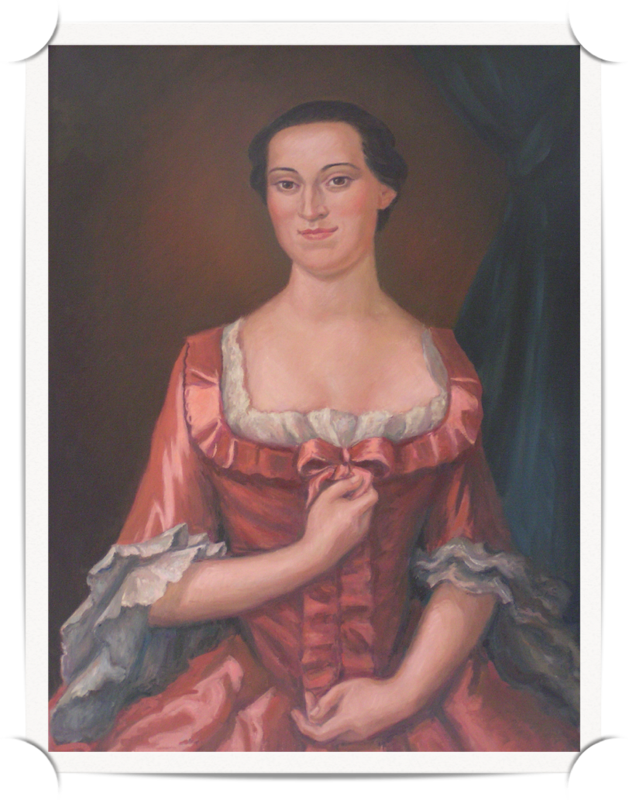
1774 Edenton Tea Party
Organized by Penelope Barker, this was the first time American women formally claimed a voice in public policy.
Wide attention on both sides of the Atlantic.
Notes:
And I’m going back to the Edenton Tea Party…right here in North Carolina. And here’s why. It was the FIRST time American women formally claimed a voice in public policy. I’ll bet you anything, this remarkable woman would have been at the forefront of woman suffrage. Here is her statement that was published and distributed widely on both sides of the Atlantic: Maybe it has only been men who have protested the king up to now. That only means we women have taken too long to let our voices be heard We are signing our names to a document, not hiding ourselves behind costumes like the men in Boston did at their tea party. The British will know who we are.
This statement describes the suffragists to a T. You will KNOW WHO WE ARE.

Slide 4
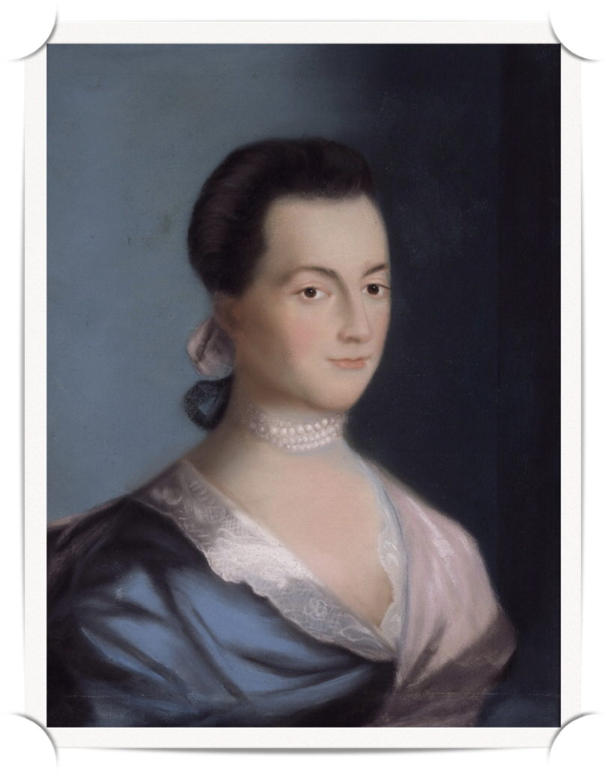
The Longest Struggle
I desire you would Remember the Ladies, and be more generous and favorable to them than your ancestors. Do not put such unlimited powers into the hands of husbands.
Notes:
The longest struggle for women is to be fully recognized in the constitution. In terms of American history, I believe that began with Abigail Adams, wife of John Adams, our 2nd President. He was off in Philadelphia helping to write the laws for our new nation. The constitution. READ SLIDE
She continues: Remember all Men would be tyrants if they could. If particular care and attention is not paid to the Ladies we are determined to foment a Rebelion, and will not hold ourselves bound by any Laws in which we have no voice or representation.

Slide 5
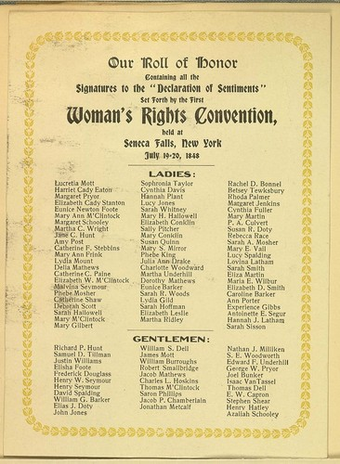
Notes:
In 1848, women and men gathered in Seneca NY at the Woman’s Rights Convention. A Declaration of Sentiments came out of this convention that outlined the rights American women should be entitled to as citizens. It was provocative…and that’s the point.. it got attention.

Slide 6
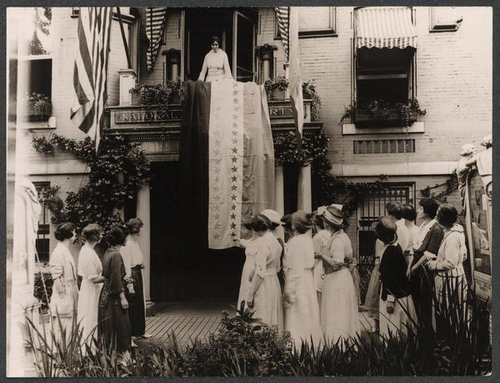
Symbols
Notes:
The use of symbols can also get attention. Girl scouts know all about symbols. The color of your uniforms, your badges. Women in Kansas, in 1867, campaigned statewide to get the vote wearing sunflowers, the state flower. So, the gold of the sunflower became one of the colors of the suffragists.
10 days ago, when the amendment was ratified, Alice Paul, President of the very activist National Women’s Party unfurled the Ratification flag to celebrate. Every time a state enacted woman suffrage a star was added to this flag with its purple, white and gold stripes. It was carried in parades. Symbols get attention.
In the Suffragist Magazine, it said this: Purple is the color of loyalty, constancy to purpose, unswerving steadfastness to a cause.
White, the emblem of purity, symbolized the quality of our purpose.
Gold, the color of light and life, is as the torch that guides.

Slide 7
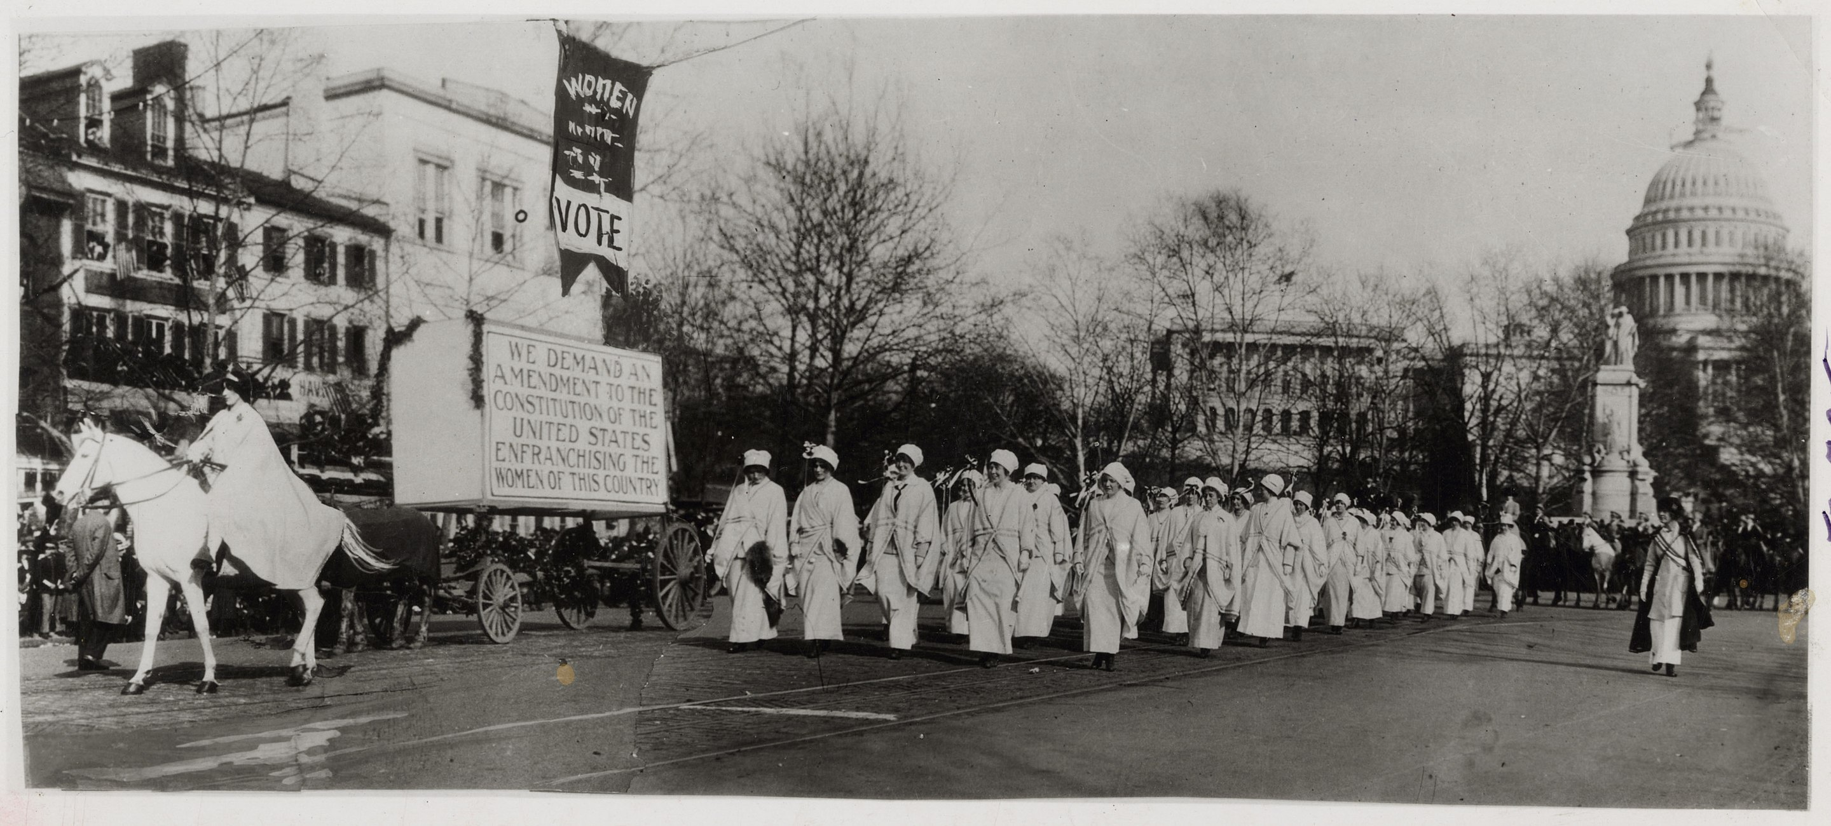
the parade
that changed everything
1913 Woman Suffrage Procession Washington DC
Notes:
After this parade, Equal suffrage leagues popped up across the country, including in North Carolina and in Wilmington. More parades, more publicity, more lobbying.

Slide 8
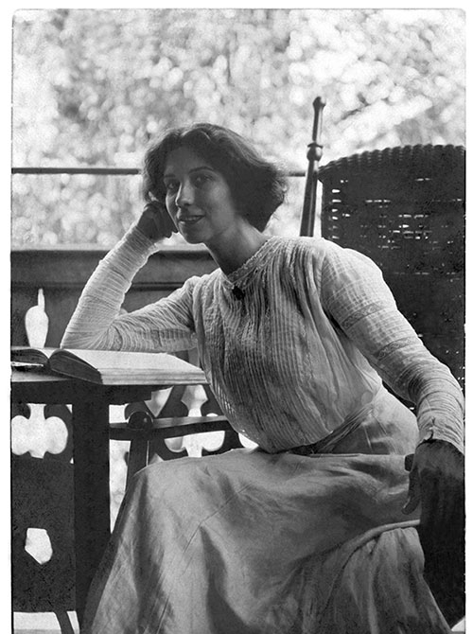
Notes:
The suffragists even used fashion to their advantage. From bloomers to throwing away the corsets to adopting looser, simpler clothing. And then there was Lip color. Elizabeth Arden, in 1912, introduced her first RED pot of color and called it “March On”. The suffragists first wore this red lip color in a 1912 parade in New York City.

Slide 9
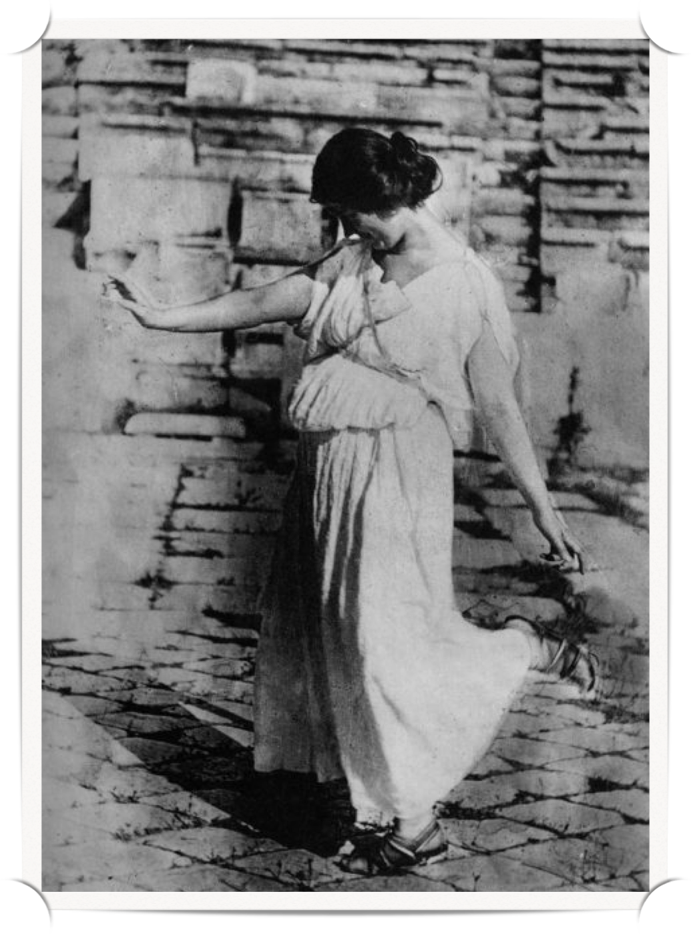
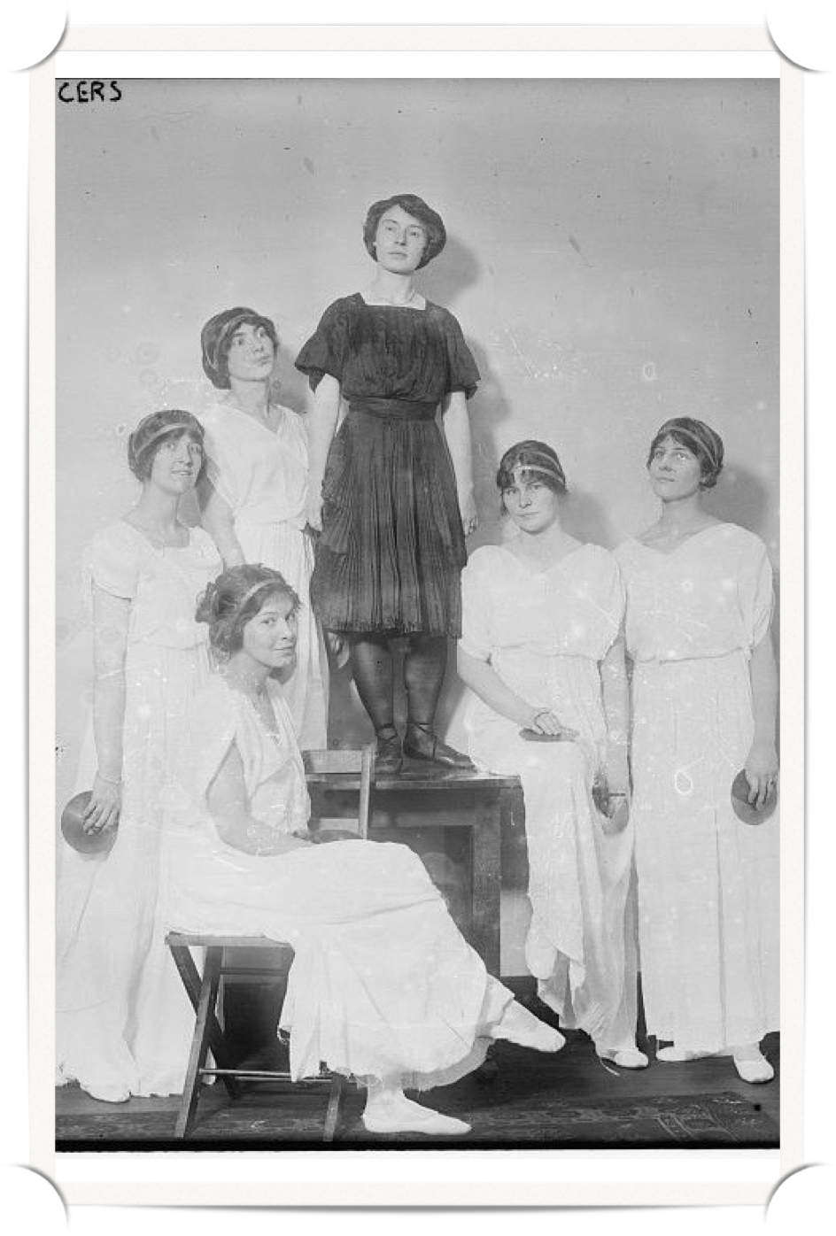
Notes:
Even dance.
Isadora Duncan, the ‘Mother of Modern Dance” was a free spirit in dance and in life. Suffragist dancers popped up, even wearing costumes with Votes for women sashes.

Slide 10
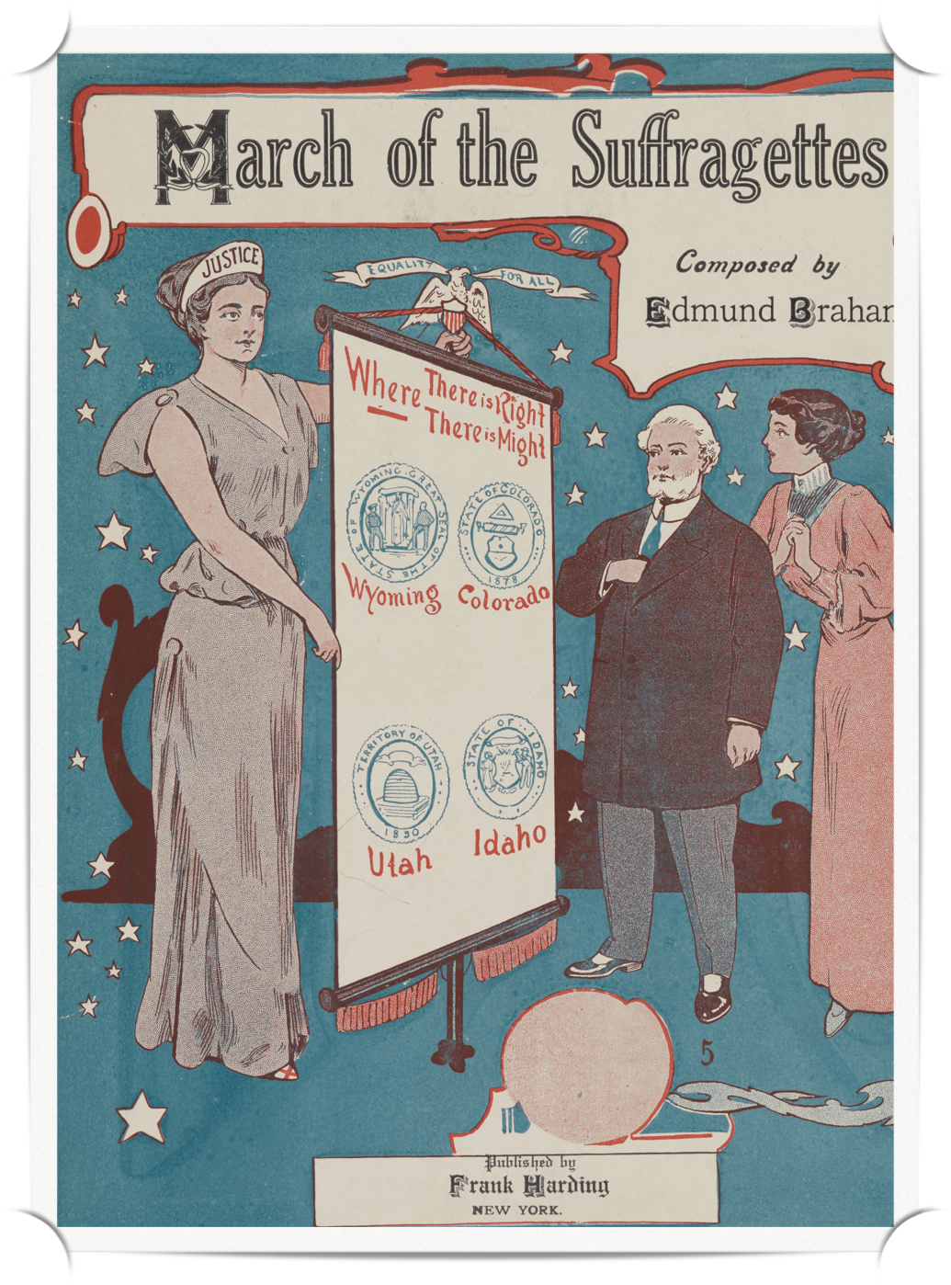
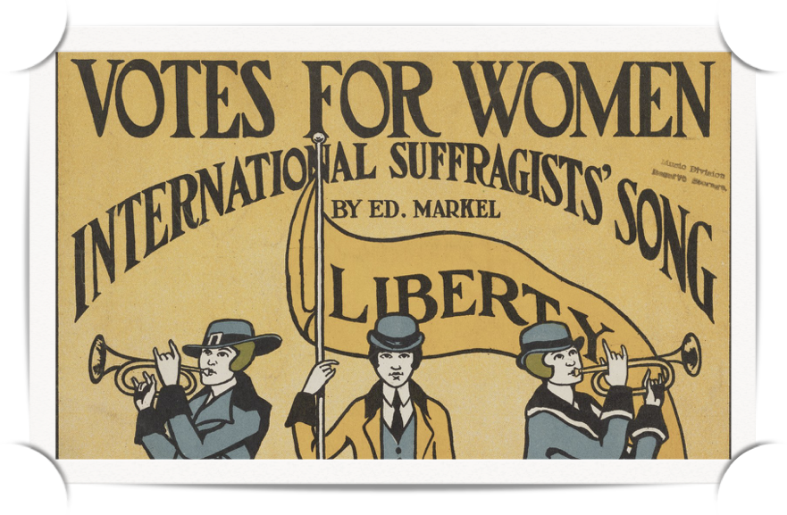
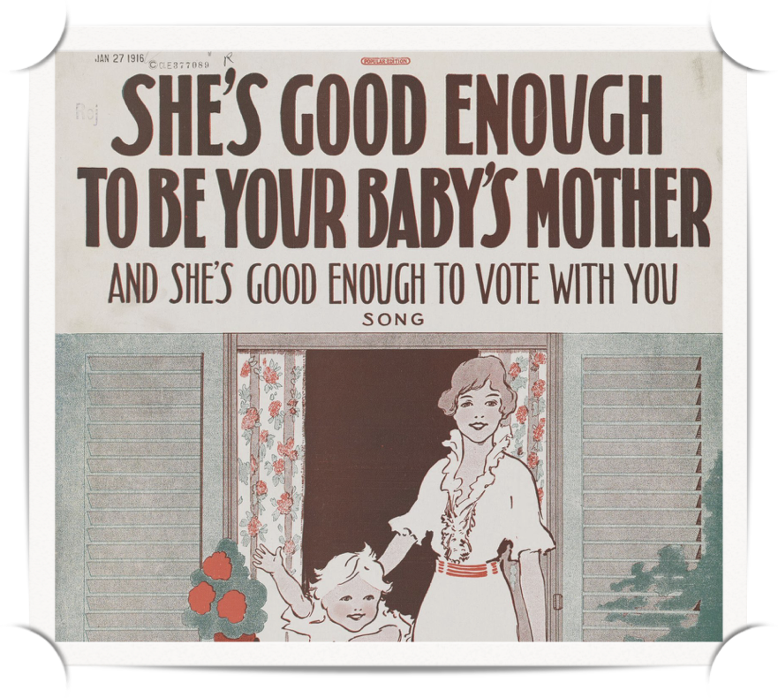

Slide 11
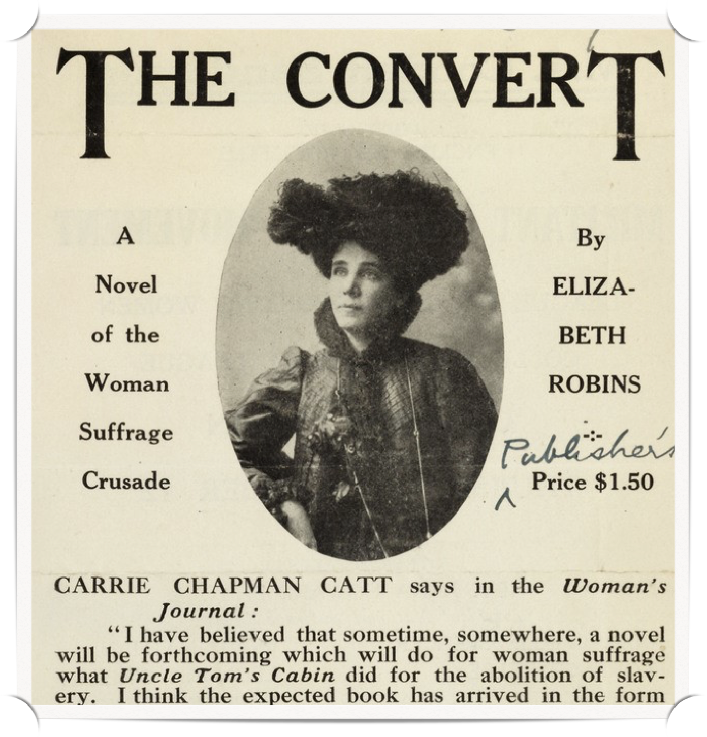
Notes:
Literature. Novels with woman suffrage as a theme. Plus poetry and theater.
And especially, Silent Film. Charlie Chaplin even has a silent film and he’s dressed as a suffragist. How many of you have seen “Your Girl and Mine”.

Slide 12
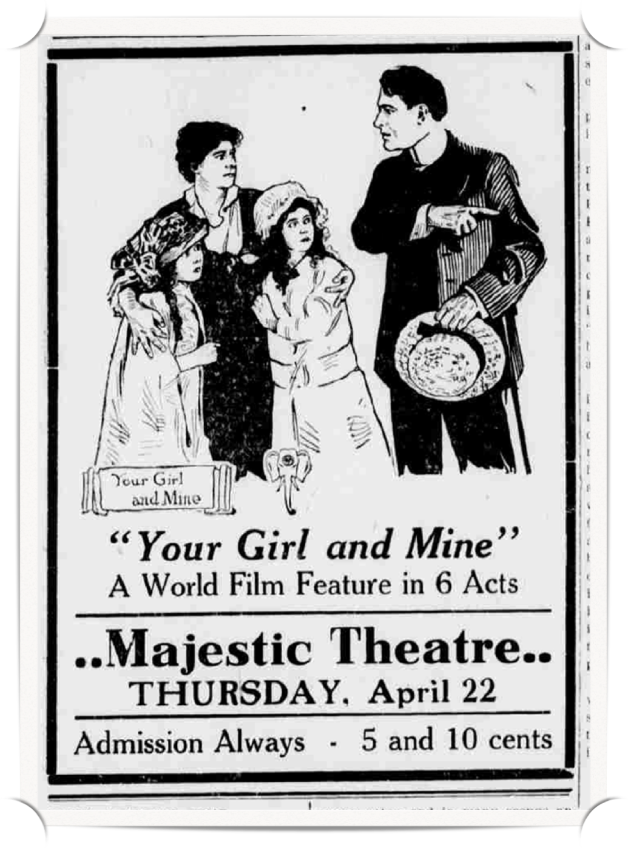
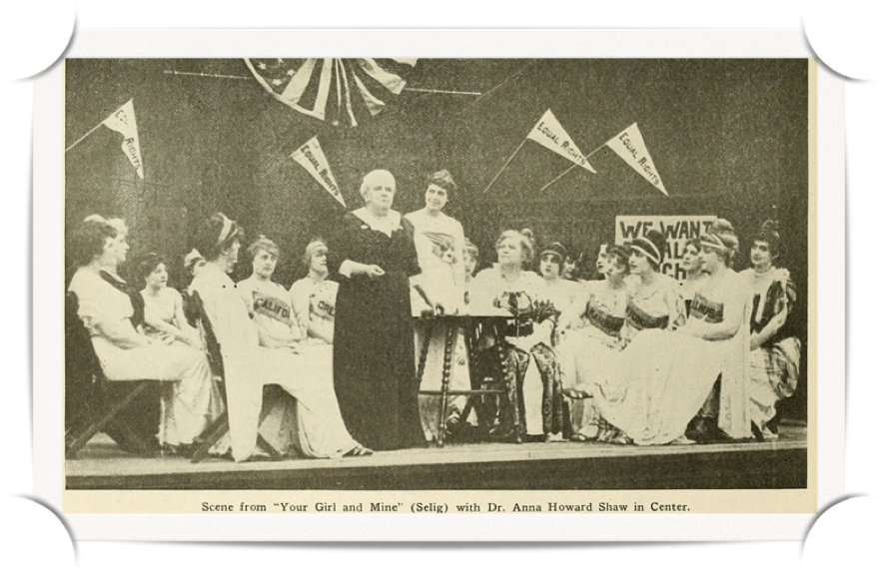
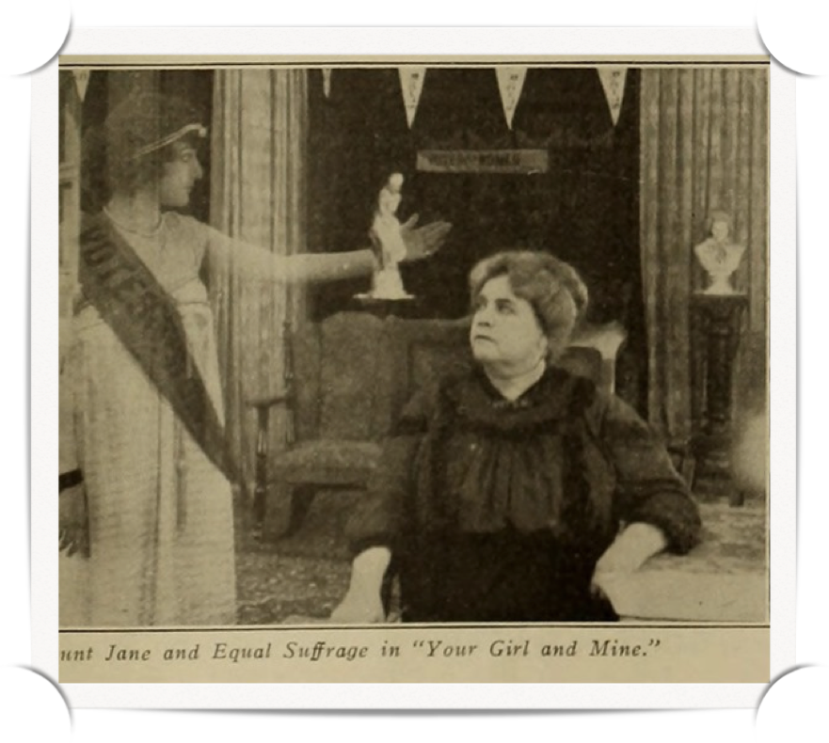
Notes:
The enterprising Raleigh Chapter of the NC Equal Suffrage Association brought this 1915 silent film YOUR GIRL AND MINE to Raleigh and raised enough funds, at 5 cents a ticket, to bring Dr. Anna Shaw, to Raleigh and to make a $10 donation to the NC Equal Suffrage Association. Dr. Shaw was President of the National American Woman Suffrage Association (NAWSA). She gave a speech to the full General Assembly at the Capitol. This was a time of intensive lobbying for NC to pass Woman Suffrage in North Carolina.
One of the leading members of NAWSA was Mrs. Medill McCormick, daughter of a US Senator and wife of the publisher of the Chicago Tribune. She approached film mogul, William N. Selif, to co-produce the film and she provided the financing.
There was a mad rush to get the film finished and into theaters in states where suffrage was on the 1914 election ballot.
The heroine, a wealthy heiress, marries for love but found her husband to be a cad. After paying his debts, and learning of his infidelity, she left him, but found she had no right to divorce or to custody of her children and he kept her money.
Her husband is killed by his abandoned mistress, but in his will he leaves all her money to his father. This grandfather puts the children to work in his factory and the poor wife is destitute. She kidnaps the children and is arrested. But all ends well and she marries the Lieutenant Governor.

Slide 13
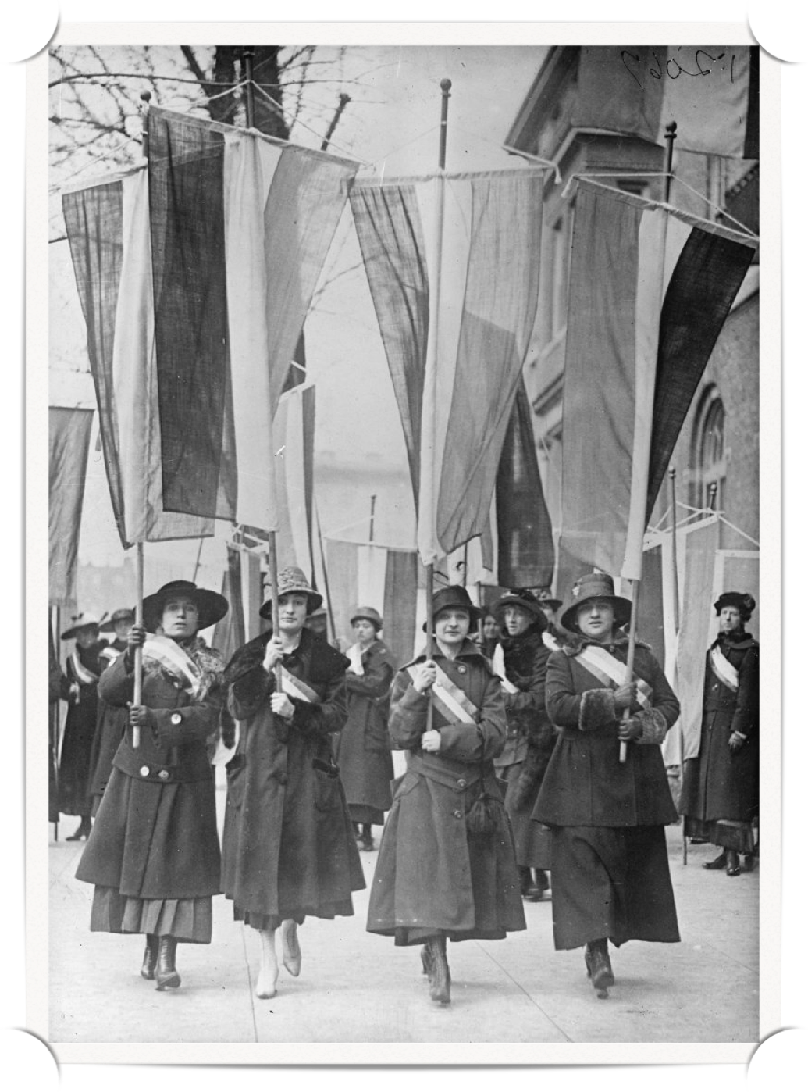
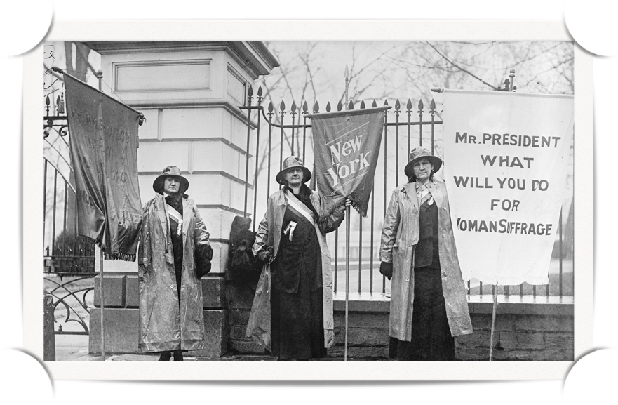
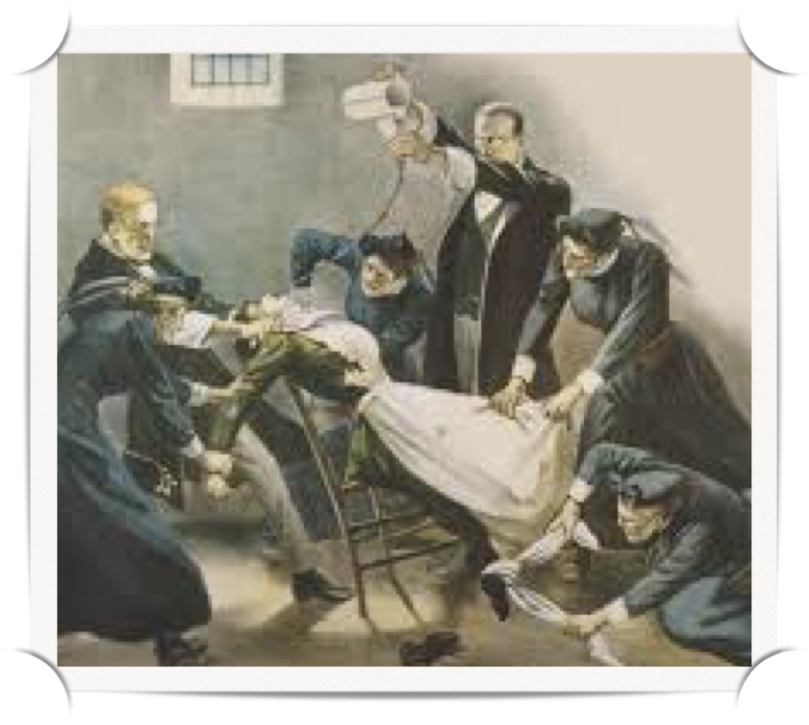
Silent Sentinels 1917
Notes:
The suffragists were learning how political theater and performance art could bring attention to their cause.
These are suffragists marching in defiance of an order banning their march. They were arrested.
These are the Silent Sentinels…the first to ever picket the White House. Here is their story.

Slide 14
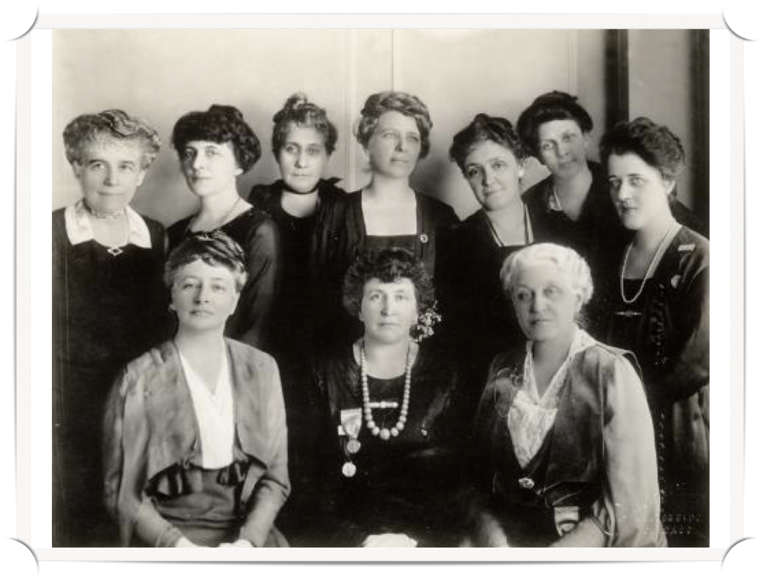
A Mighty Political Experiment
Notes:
A few months ago, when we knew the 19th amendment would pass this year, the National American Woman Suffrage Association held its convention and founded the League of Women Voters. This is their first board. These were the suffragists. This new League will help 20 million women carry out their new responsibilities as voters and to use their power to shape public policy. They will begin NOW using their skills to lobby for women’s and children’s issues.
I’m Bonnie Bechard with the League of Women Voters, A Mighty Political Experiment, and for 100 years the league has been fighting for voting rights, equality of opportunity, and a more perfect democracy.

